Slide 1
SMART SHOPPING SYSTEM
Submitted By
PATEL PRINCE D.
PATEL ARYAN D.
(18IT096)
(18IT078)
Under the Supervision of
PROF.HARSH PATEL

Slide 2
To develop supermarkets process
RFID based
in order to expedite billing
billing system for

Slide 3
INTRODUCTION
Now a day’s shopping at big malls is becoming a daily activity in metro cities. The huge rush at malls on holidays and weekends.
After purchase, at the billing counter the cashier prepare the bill using bar code reader which is a time consuming process and results in long queues.
The aim is to develop a system that can be used in shopping malls to solve the rush at billing counter using RFID.

Slide 4
EXISTING SYSTEM
Manual billing.
Use Barcode for billing.
Human staff is needed for billing.
Low product cost but over all expenses are much high.
Getting product information is difficult & time consuming.

Slide 5
PROPOSED SYSTEM
Automatic billing.
Use RFID TAG for billing.
No need of any staff for billing.
Product is little expensive but over all expense is much low.
Getting product information is easy and no extra time
needed.

Slide 6
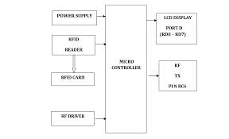
SYSTEM ARCHITECTURE

Slide 7
METHEDOLOGY
Every product has an RFID tag which contains a Unique ID.
If there needs to be a purchase done, then that product can be dropped in the cart where the RFID reader reads the tag. The information of the product is extracted and displayed on the LCD screen. At the same time billing information is also updated.
When a customer wants to remove any product from the trolley,
then that product needs to be scanned again.

Slide 8
At the same time the billing information is updated. The total
amount of purchases is also displayed on screen.
These steps are repeated until the end of shopping .
The customer can straight away pay the bill and leave.
Inventory status of the products is also updated at the end of shopping. Simultaneously the temporary data present in microcontroller is reset, so that it can be reused.

Slide 9
REQUIREMENTS
Hardware Requirement
RFID tags
RFID reader
LCD Display (16x2)
Microcontroller Arduino uno
Software Requirements
Arduino IDE

Slide 10
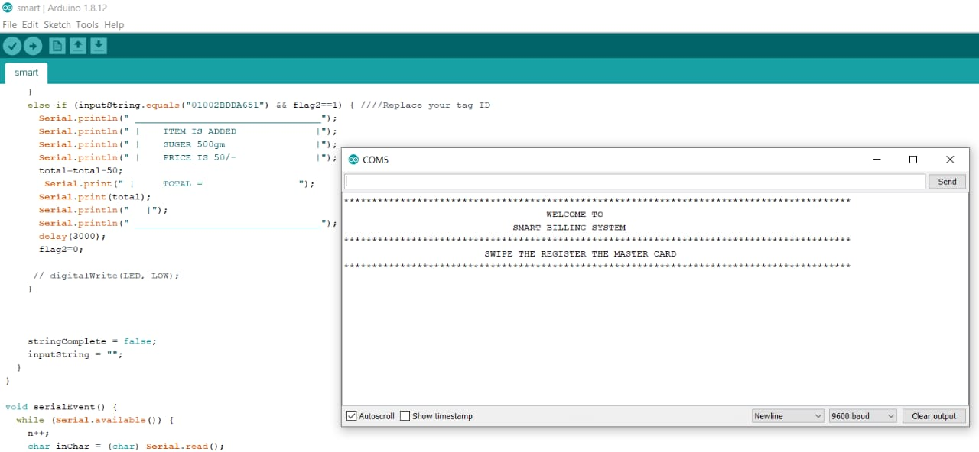
SCREENSHOTS
Fig. Server side

Slide 11
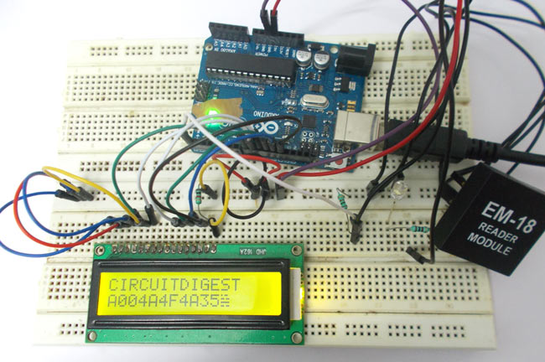
Fig. Product details

Slide 12
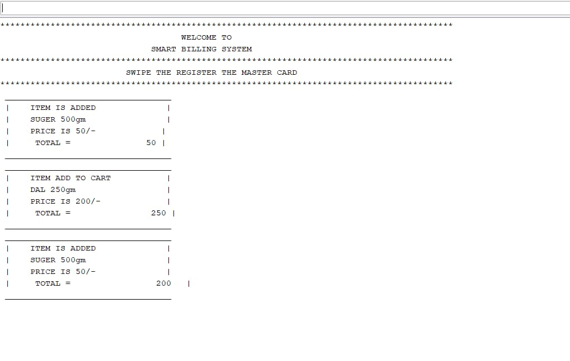
Fig. Trolley Details

Slide 13
CONCLUSION
This project “ Smart Trolley”, name suggests the billing technique is improved. It is less time consuming as compared to regular billing technique. It is more reliable and provides ease for shopping. Here we conclude that the proposed system is time saving i.e. faster check out process.This system Reduces require number of salesman at the counter.

Slide 14
REFERENCES
Amine Karmouche, Yassine Salih-Alj, "Aisle-level Scanning for Pervasive RFID- based Shopping Applications",
Mr. P. Chandrasekar, Ms. T. Sangeetha, "Smart Shopping Cart with Automatic Central Billing System through RFID and ZigBee".

Slide 15
Thank You

